Slide 1

Telematics in Insurtech: Driving the Future of Risk
A concise overview for insurance professionals and product managers on leveraging telematics for better risk management and customer engagement.

Slide 2
Chapter 1: Understanding Telematics
What Exactly is Telematics?
Definition and Components
Key Data Captured
How it Works
Hard Braking and Acceleration Events
Data is collected via a device (often an OBD plug-in or built-in OEM system), transmitted wirelessly, and then processed to provide actionable insights into driver risk profiles.
Telematics is a blend of telecommunications and informatics. It involves monitoring vehicles through GPS, on-board diagnostics (OBD), and other sensors to gather data on location, speed, driving behaviour, and vehicle health.
Speeding Violations
Mileage and Routes Driven
Time of Day Driving

Slide 3
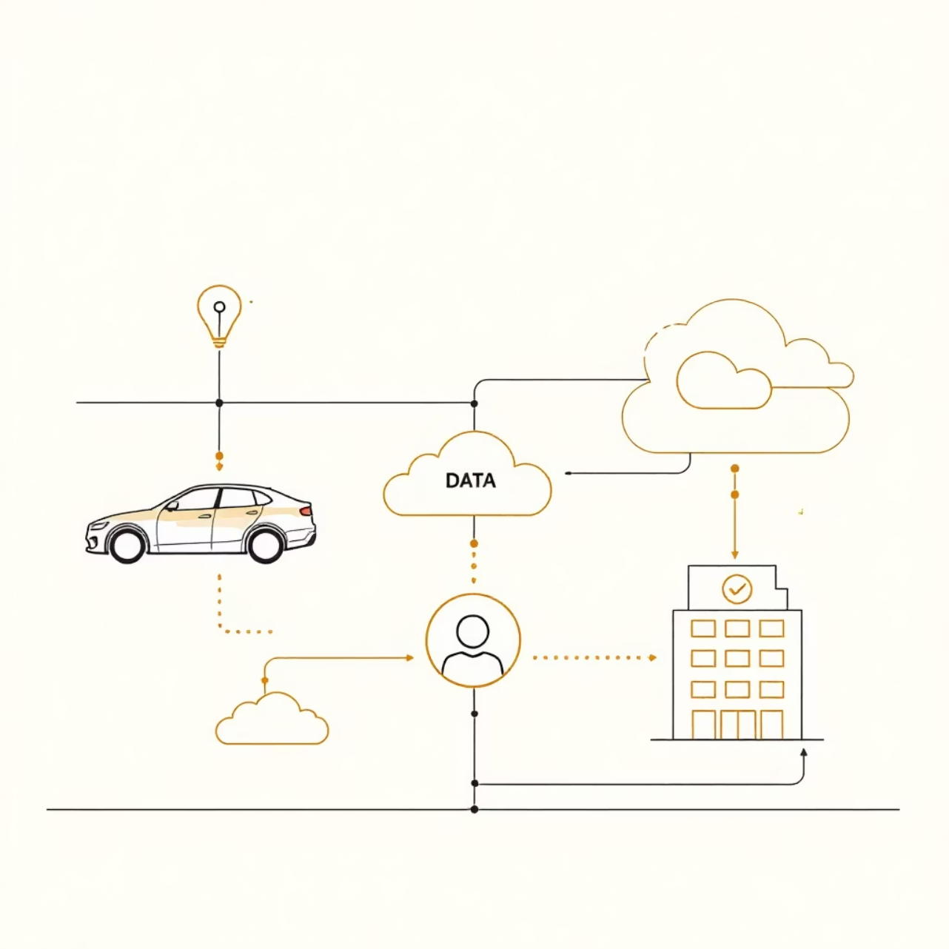
The Role of Telematics in Insurtech
Telematics is a foundational technology for modern Insurtech, fundamentally shifting the insurance model from static, historical risk assessment to dynamic, real-time pricing.
Usage-Based Insurance (UBI): The primary application, where premiums are directly tied to how, when, and where a vehicle is driven.
Enhanced Risk Segmentation: Insurers can move beyond traditional demographic data to create highly accurate risk pools based on actual driving behaviour.
Improved Claims Management: Accurate crash reconstruction data speeds up claim validation and reduces fraudulent activity.

Slide 4


Chapter 2: Core Applications
Usage-Based Insurance (UBI) Models
Pay-As-You-Drive (PAYD)
Pay-How-You-Drive (PHYD)
Manage-How-You-Drive (MHYD)
Premiums are based purely on mileage driven. This model appeals to low-mileage drivers and offers immediate transparency in pricing.
The most common model, where premiums are calculated based on driving behaviour (speeding, harsh braking, time of day). This incentivises safer driving.
Focuses on fleet management and commercial lines, providing coaching and feedback to drivers to proactively manage risk and maintenance.

Slide 5



The Competitive Advantages for Insurers
Actuarial Precision
Innovation and Differentiation
Proactive Risk Mitigation
Greater data granularity leads to refined pricing models, enabling better loss ratio management and profitability.
Insurers can actively encourage safer driving and potentially prevent accidents, shifting the focus from reaction to prevention.
Telematics products allow insurers to stand out in a competitive market by offering personalised, value-added services.
Leveraging telematics transforms insurance from a financial safety net into a proactive partner in risk management.

Slide 6



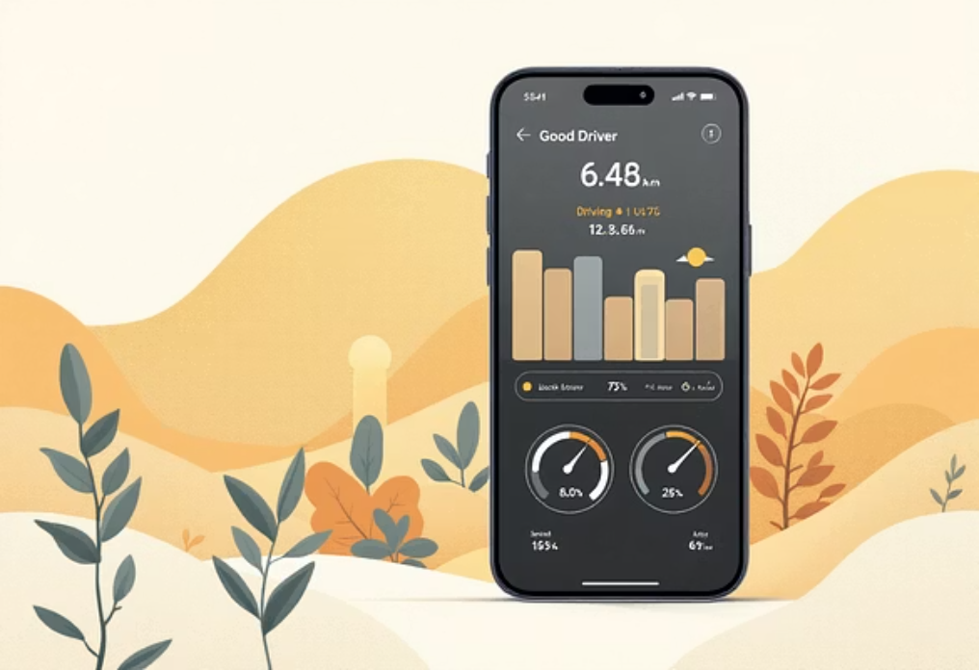

Benefits for the Customer
Lower Premiums
Personalised Feedback
Value-Added Services
Good drivers receive significant discounts, often saving 10-30% on their auto insurance costs.
Drivers receive data-driven insights on their habits, empowering them to become safer and more efficient drivers.
Beyond pricing, telematics enables services like stolen vehicle tracking, roadside assistance, and maintenance alerts.

Slide 7
Chapter 3: Challenges and Disadvantages
Despite its benefits, the adoption of telematics faces significant hurdles, primarily centred around data and consumer trust.
Data Standardisation
Data Privacy Concerns
A lack of uniform data formats across different OEM and aftermarket devices complicates data ingestion and processing for insurers.
Customers often hesitate due to fear of constant surveillance and how their granular data will be used or shared by the insurer.
Adverse Selection Risk
Technology Integration Cost
If only safe drivers opt-in, the insurer's non-telematics pool may become disproportionately filled with high-risk drivers, potentially destabilising traditional premium models.
Implementing robust telematics platforms, including device distribution, connectivity, and analytics infrastructure, requires significant initial investment.

Slide 8

Mitigating Implementation Roadblocks
Privacy Risks
Transparency
Security
Customer Trust
Overcoming these challenges requires strategic focus on transparency, secure technology, and demonstrating clear customer value beyond just discounted pricing.
Focus Areas
Clear communication on data usage and anonymisation.
Offering "soft" telematics solutions (e.g., smartphone apps) to reduce hardware costs.

Slide 9

Key Takeaways: The Road Ahead
Telematics is essential for the future of auto insurance, enabling genuine risk personalisation.
1
The value proposition must shift from 'surveillance' to 'safety' and 'savings' to ensure customer adoption.
2
Insurers must invest in robust analytics and data security to leverage the full potential of UBI.
3

